Slide 1
Link Layer Addressing

Slide 2
Overview
MAC Addresses
Address Resolution Protocol (ARP)
Sending a Datagram to a Node off the Subnet

Slide 3

Hello!
I am Syed Jahangir

Slide 4
MAC Address
1

Slide 5
Questions Popping in your head
Are we out of Mac address?
Where is it used?
What is a MAC Address?
Why do we need MAC Address when we already have IP Addresses?
How is it assigned to an interface?

Slide 6
What’s a MAC Address?
Media Access Control address is the physical address that uniquely identifies a hardware interface.
Also known as LAN Address.
It is a 48-bit hexadecimal address.
The format of a MAC address is MM:MM:MM:SS:SS:SS.
MAC address is burned into the ROM of Network Interface Card (NIC).
Each computing device has a unique MAC Address.

Slide 7
Where is it used?
Every computer needs to be connected with each other in order to communicate with each other.
It is the low level basis through which ethernet based network functions.

Slide 8
How are MAC addresses assigned?
first
second
third
last
IEEE
Acquire
Allocation
Creation
IEEE manages the MAC address space.
Companies purchase the chunk of the address space consisting of 2²⁴ address for a nominal fee.
IEEE allocates the chunk of 2²⁴ addresses by fixing the first 24 bits of a MAC address.
Companies create unique combination of last 24 bits.

Slide 9
Are we out of MAC addresses?
World population is around 7.6 billion.

Slide 10
281,474,976,710,656 / 7,600,000,000 = 37306
MAC Address is 6 byte long giving it 2⁴⁸ possible addresses.
That means each and every person in the world can have 37306 different devices without any muddles.
Whoa! Isn’t that a big number ?

Slide 11
IP vs MAC
32- bit
48- bit
Network-Layer
Link-Layer
Hierarchal
Not Portable
Flat
Portable
Street Address
Aadhaar Number

Slide 12
Address Resolution Protocol
2

Slide 13
What is ARP ?
Why do we need ARP ?

Slide 14
Address Resolution Protocol
It is the protocol which translates between MAC address and IP address.
ARP takes destination's IP and returns its MAC address.

Slide 15
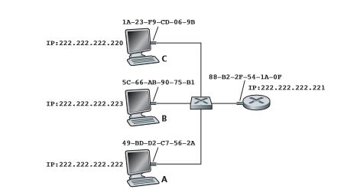

Slide 16
How does ARP work?
Each host stores an ARP table in its memory.
This table contains the mapping between IP and MAC addresses.
Each entry in ARP table will have a Time-to-live(TLL) value after which they will be deleted from the table.
ARP table needn't contain entry for all hosts present in the subnet.

Slide 17
Let's see how ARP works with help of an example

Slide 19
Case 1: Destination's entry is present in sender's ARP table
This is the easiest case to handle.
The sender just needs to look into ARP table to find destination's MAC address which is mapped to its IP address.

Slide 20
Case 2: Destination's entry isn't available in sender's ARP table
Sender uses ARP protocol to resolve the address.
First, the sender generates ARP packet which has several fields including sending and receiving IP and MAC addresses.
The purpose of this packet is to query all hosts and routers on the subnet to determine the MAC address corresponding to the IP address which is being resolved.

Slide 21
Sender passes its ARP query packet to the adapter and indicates that the packet should be sent to MAC broadcast address i.e., FF-FF-FF-FF-FF-FF.
The adapter encapsulates the ARP query packet into a link layer frame, uses broadcast address as the destination MAC address and transmits the frame into the subnet.
This frame is received by all the other adapters of the subnet and the ARP query in the frame is passed to its ARP module.
The adapter which contains desired mapping sends a response ARP packet to the querying node.
The querying node then updates its table with the obtained mapping and then sends IP datagram to the destination MAC.

Slide 22
Interesting points about ARP
ARP query packet is sent within a broadcast frame whereas ARP response packet is sent within a standard frame.
ARP is plug-and-play i.e., ARP table gets built automatically and doesn't require any system administrator to configure it.
If a host is disconnected from the subnet, all the entries corresponding to the disconnected host get deleted after time-to-live(TLL) elapses.

Slide 23

Hello!
I am Anirudh Kannan V P

Slide 24
Sending a Datagram to a Node off the Subnet
3

Slide 25


Slide 26
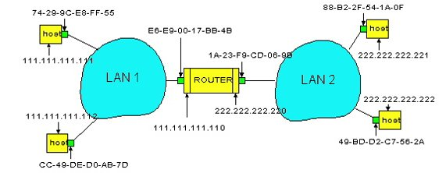
Two Subnets interconnected by a router

Slide 27
There are 2 types of nodes: hosts and routers
Interesting Things to Note
Each host has exactly one IP address and one mac address
But a router has an 2 IP addresses , 2 ARP modules and 2 adapters. Each adapter in the network has its own MAC address.

Slide 28
Interesting Things to Note
The network on the left LAN 1 has network address 111.111.111.111/24 and the network on the right has network address 222.222.222/24
Thus all of the interfaces connected to Subnet 1 will have address of the form 111.111.111.xxx and all of the interfaces connected to Subnet 2 will have address of the form 222.222.222.xxx

Slide 29
What is the goal?
Send datagram from A to B via R
Assuming that A knows B's IP address

Slide 30
The Process
Suppose 111.111.111.111 wants to send a datagram to 222.222.222.222. The Sending host passes its datagram to its adapter as usual.
But the sending host must also indicate the appropriate destination MAC address

Slide 31
Always think before you act
A logical quick guess would be to use the appropriate MAC address of the host 222.222.222.222 adapter namely 49-BD-D2-C7-56-2A
But this is a Blunder as none of the adapters on Subnet 1 would bother to send the IP datagram to its network layer as frame s destination address would not match the MAC address of any adapter on Subnet 1

Slide 32
Real Life Analogy
Remote Pen and Paper CCN Exam.

Slide 33
A creates datagram with source A, destination B
A uses ARP to get R’s MAC address for 111.111.111.110
A creates link-layer frame with R's MAC address as destination, frame contains A-to-B IP datagram
A’s adapter sends frame.

Slide 34
R’s adapter receives frame
R removes IP datagram from Ethernet frame, sees its destined to B
R uses ARP to get B’s MAC address
R creates frame containing A-to-B IP datagram sends to B
B receives A's datagram and thus our goal is achieved.

Slide 35
Conclusion
ARP for Ethernet is defined in RFC 826
Which will be discussed by the next groups
Be sure to Practice Questions on this topic before the exam

Slide 36
Thanks!
😉
Any questions?

